Slide 1

Fine food Rating Estimation
Cognitive Computing Project
Zăvelcă Miruna-Andreea
Master Natural Language Processing 412

Slide 2
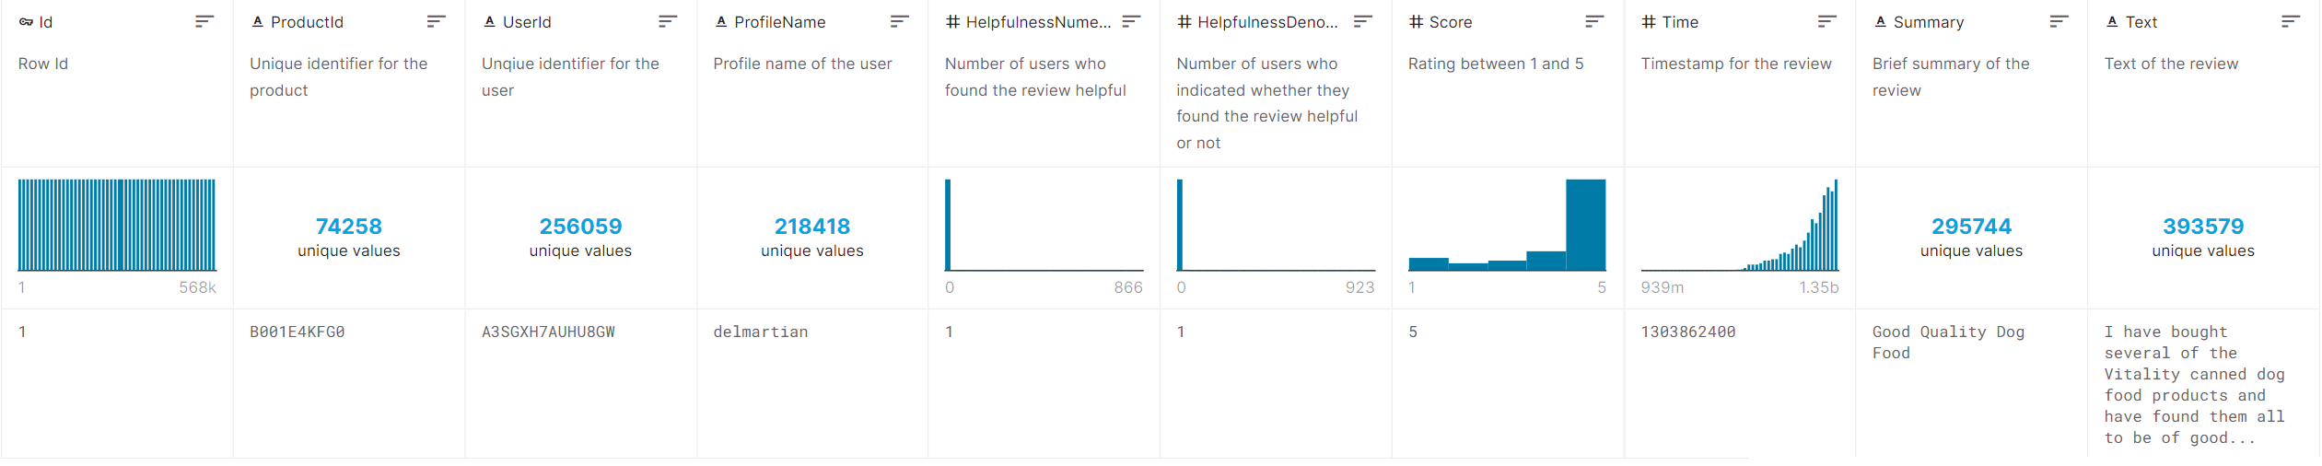
Preliminaries: Dataset info
Source: Kaggle - Amazon Fine Food Reviews
The dataset has 5 relevant columns and more than 500k rows
Real life application: infering rank of approval based on a few sentences

Slide 3
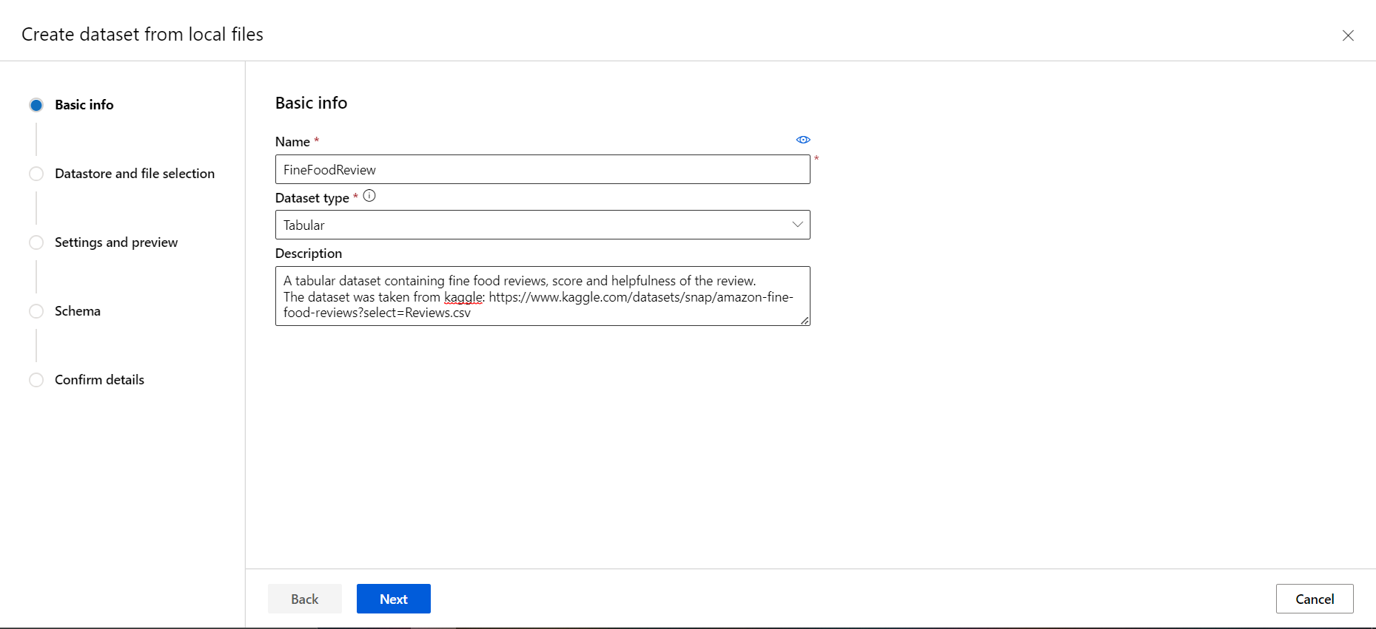
Add dataset

Slide 4
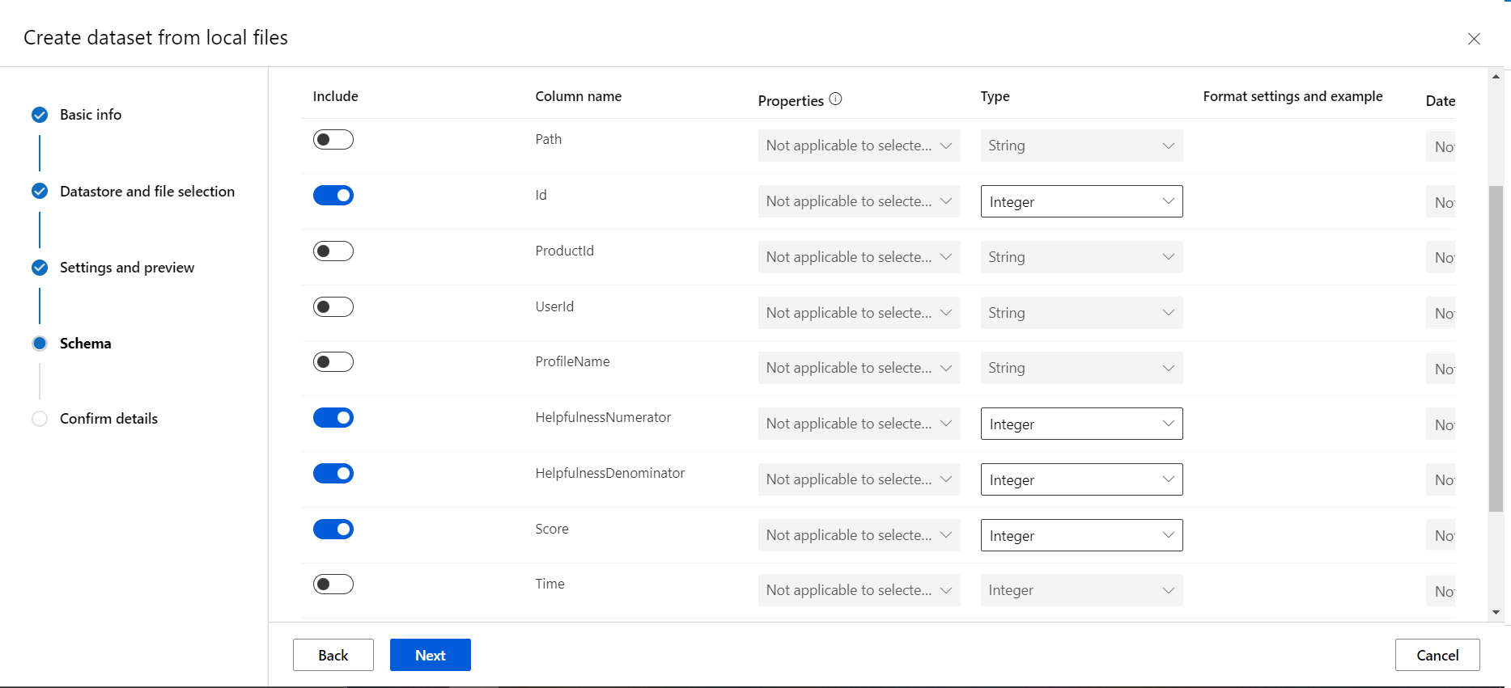
Filter columns

Slide 5
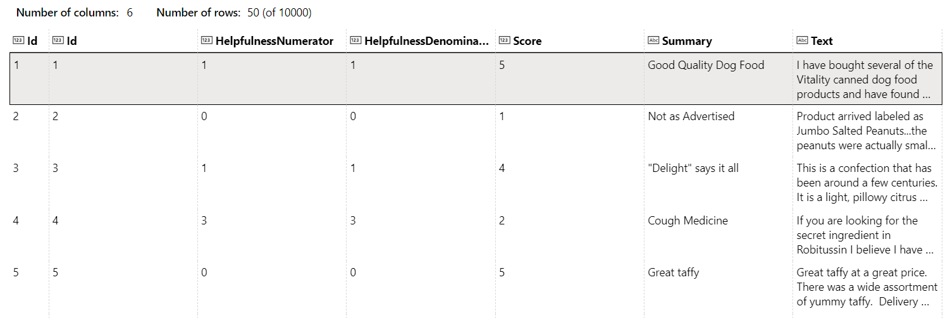
Dataset after filtering

Slide 6
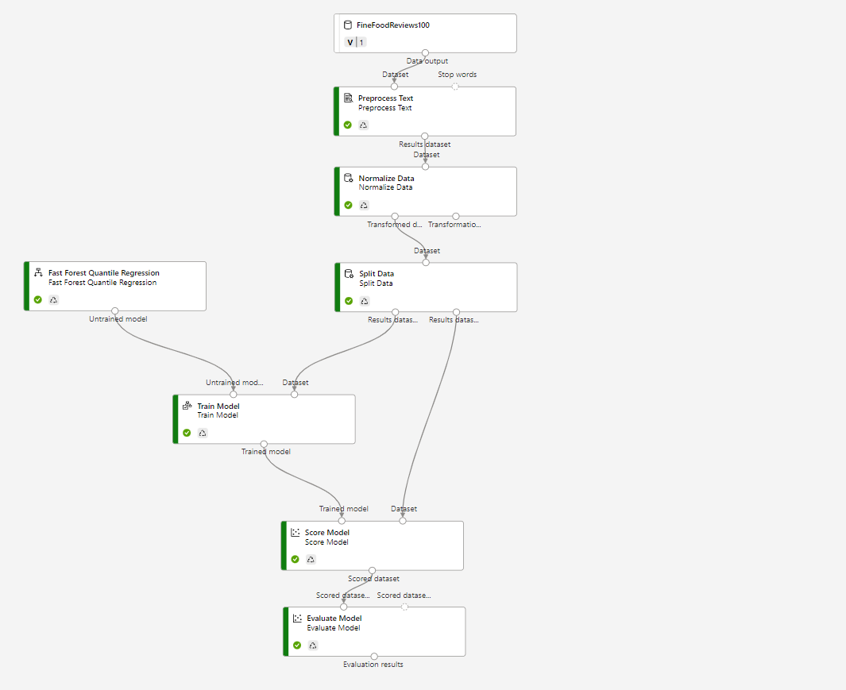
App design
Preprocess Text: Keep numbers, special characters and duplicate characters
Normalize Data: the chosen dataset has preponderently maximum scores (5)
Split Data: 0.8 for train, 0.2 test

Slide 7
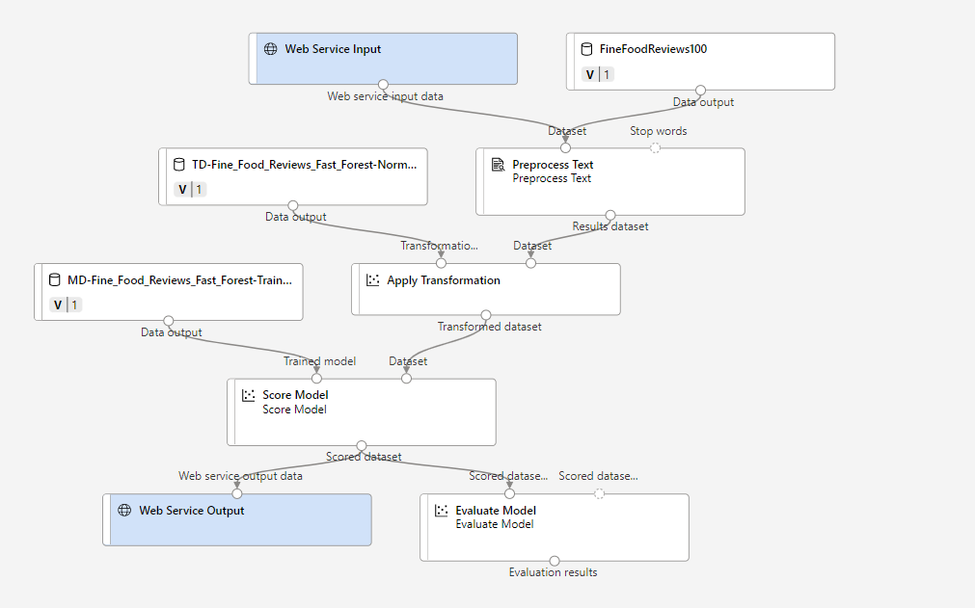
Inference pipeline

Slide 8
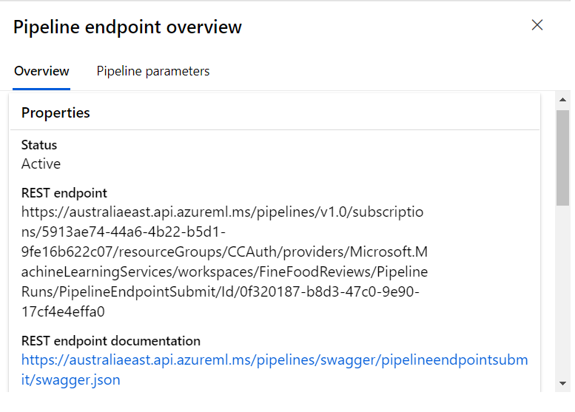
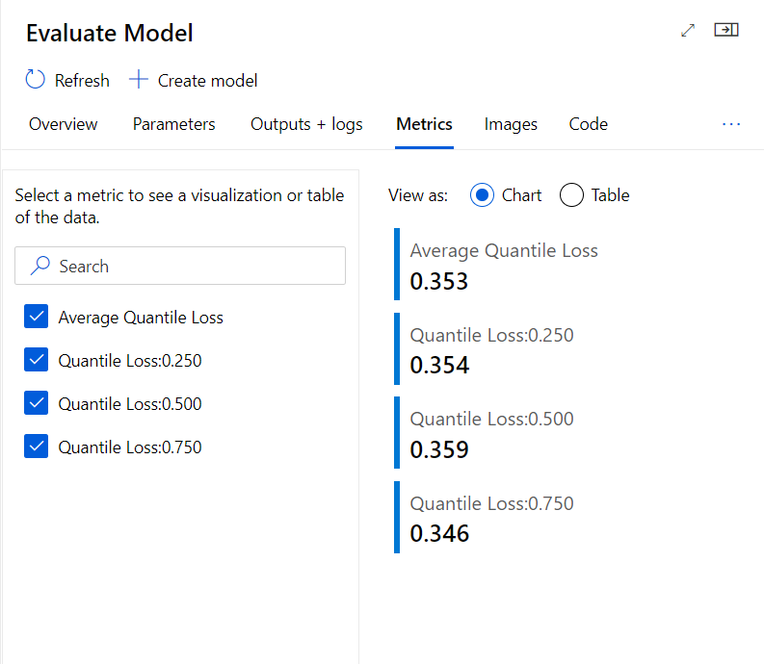
conclusions

Slide 9
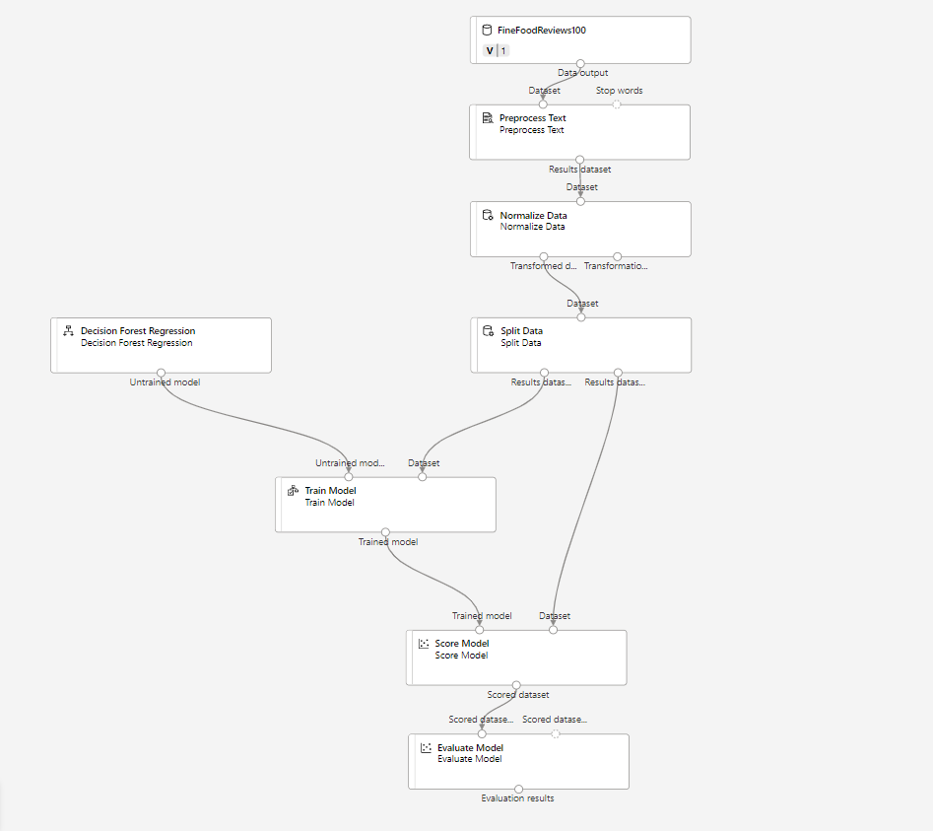
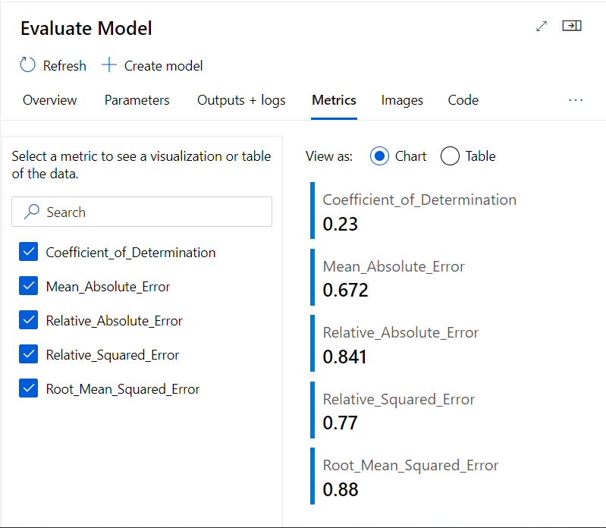
alternative approach

Slide 10

Thank you for your attention

